Slide 2
An Introduction to Statistics An Active Learning Approach
Chapter 11: One-Way Independent Samples ANOVA

Slide 3
Topics to Cover
Identify when to use an independent samples ANOVA
Explain the logic of the ANOVA F ratio
Explain how measurement error, individual differences, and treatment effects influence the numerator and the denominator of the F ratio
Write null and research hypotheses using symbols and words

Slide 4
Topics to Cover
Complete an ANOVA summary table by computing the degrees of freedom, SSs, MSs, and F ratio
Define a critical region and determine whether you should reject or fail to reject the null hypothesis
Compute effect sizes and describe them
Explain when and why post hoc tests are necessary

Slide 5
Topics to Cover
Summarize the results of an independent samples ANOVA using American Psychological Association (APA) style
Use SPSS to compute an independent samples ANOVA, including post hoc tests
Interpret the SPSS output for an independent samples ANOVA

Slide 6
Independent Samples ANOVA
The independent samples ANVOA can compare two or more sample means at the same time to determine whether the deviation between any pair of sample means is greater than would be expected by sampling error.
Notes:
Learning Objective: Identify when to use an independent samples ANOVA

Slide 7
Other Names
ANOVA is an abbreviation for analysis of variance.
The independent samples ANOVA is also called a one-way ANOVA.
Notes:
Learning Objective: Identify when to use an independent samples ANOVA

Slide 8
Logic of the ANOVA
An ANOVA analyzes the variance of scores both between and within IV conditions in an attempt to determine whether the different treatment conditions affect scores differently.
Notes:
Learning Objective: Explain the logic of the ANOVA F ratio

Slide 9
Logic of the ANOVA
Three things affect the variance of scores:
Measurement error: There will always be variance in scores between people because variables cannot be measured perfectly.
Individual differences: There will always be variance in scores between people because people are naturally different from each other.
Treatment effect: There might be variance in scores between groups because groups experienced different IV conditions or treatments.
Notes:
Learning Objective: Explain the logic of the ANOVA F ratio

Slide 10
Logic of the ANOVA
The ANOVA analyzes the relative amounts of these three sources of score variability—namely, (1) treatment effects, (2) individual differences, and (3) measurement error—to produce an F statistic.
Notes:
Learning Objective: Explain the logic of the ANOVA F ratio

Slide 11
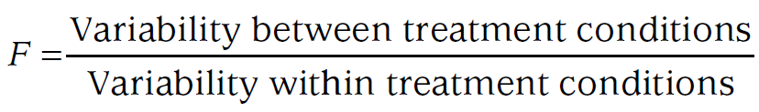
Logic of the ANOVA
One conceptual formula of the ANOVA is a ratio of the variability between treatment conditions to the variability within treatment conditions.
Notes:
Learning Objective: Explain the logic of the ANOVA F ratio

Slide 12
Logic of the ANOVA
Another conceptual formula of the ANOVA is:
Notes:
Learning Objective: Explain the logic of the ANOVA F ratio

Slide 13
Logic of the ANOVA
The numerator is the variability in scores that exists across the different treatment groups (IV conditions), which is called between-group variability or between-treatment variability.
Notes:
Learning Objective: Explain the logic of the ANOVA F ratio
Learning Objective: Explain how measurement error, individual differences, and treatment effects influence the numerator and the denominator of the F ratio

Slide 14
Logic of the ANOVA
There are three possible sources for between-treatment variability
Treatment effects
Individual differences
Measurement error
Notes:
Learning Objective: Explain the logic of the ANOVA F ratio
Learning Objective: Explain how measurement error, individual differences, and treatment effects influence the numerator and the denominator of the F ratio

Slide 15
Logic of the ANOVA
The only sources for differences within a treatment condition are
Individual differences
Measurement error
The denominator of the F ratio is often called the error term because it only contains variance created by sampling error.
Notes:
Learning Objective: Explain the logic of the ANOVA F ratio
Learning Objective: Explain how measurement error, individual differences, and treatment effects influence the numerator and the denominator of the F ratio

Slide 16
An Example ANOVA Problem

Slide 17
An Example ANOVA Problem
Suppose you want to compare cognitive behavioral therapy (CBT) and psychodynamic therapy (PDT) as treatments for depression.
You identify a sample of people with major depression and randomly divide them into three different groups.

Slide 18
An Example ANOVA Problem
One group undergoes CBT for 6 months.
A second group undergoes PDT for 6 months.
A third group functions as a control group and receives no treatment (NT).

Slide 19
An Example ANOVA Problem
After 6 months, you assess their levels of depression using the Beck Depression Inventory (BDI; scores range from 0 to 63), with higher scores indicating greater depression.
The depression scores you found for each group are listed in Table 11.1.
Notes:
In this study, the IV is the type of treatment (CBT, PDT, or NT), and the DV (dependent variable) is each person’s
depression score on the BDI.

Slide 20
An Example ANOVA Problem
In this study, the IV is the type of treatment (CBT, PDT, or NT).
The DV (dependent variable) is each person’s depression score on the BDI.

Slide 21
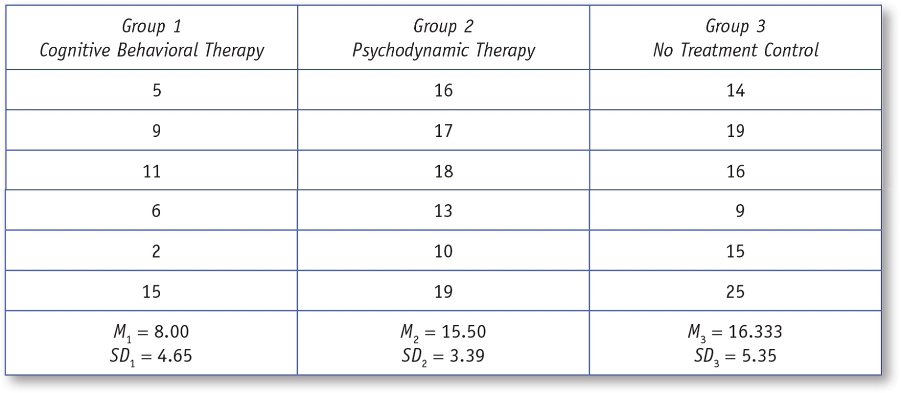
Table 11.1: Depression Scores After Three Different Types of Treatment
Notes:
p. 372 “The statistical assumptions for independent t tests and independent ANOVAs are identical.”

Slide 22
Step 1: Examine the Statistical Assumptions
Data independence
the depression scores of individuals must be measured without one participant’s score influencing another’s
Notes:
p. 372 “The statistical assumptions for independent t tests and independent ANOVAs are identical.”

Slide 23
Step 1: Examine the Statistical Assumptions
Appropriate measurement of variables assumption
DV, depression score, must be measured on an interval/ratio scale.
IV must identify how the three therapeutic treatments are different.

Slide 24
Step 1: Examine the Statistical Assumptions
Normality assumption
The distribution of sample means for each condition must have a normal shape.
This will be the case if the original populations are normal or if the sample sizes for each condition are near 30.
Notes:
p. 370 “With a sample size of 30, it is very likely that the assumption of normality will be met. However, other issues need
to be considered when designing a study, including Type I error, statistical power, and effect sizes. When designing
a study, we encourage you to consult Jacob Cohen’s (1992) classic article.”

Slide 25
Step 1: Examine the Statistical Assumptions
Homogeneity of variance assumption
If any one of your conditions has a standard deviation double that of another, the homogeneity of variance assumption might be violated.
However, if the sample sizes are similar this assumption can be violated without a problem (see Field, 2013).

Slide 26
Step 2: State the Null and Research Hypotheses Symbolically and Verbally
The null states that the three population of people being studied (those getting CBT, PDT, or NT) have the same mean depression scores.
The research hypothesis states that at least one population mean is different from at least one of the others.
Notes:
p. 373 “Note that the research hypothesis is not specifying that all of the population means are different”

Slide 27
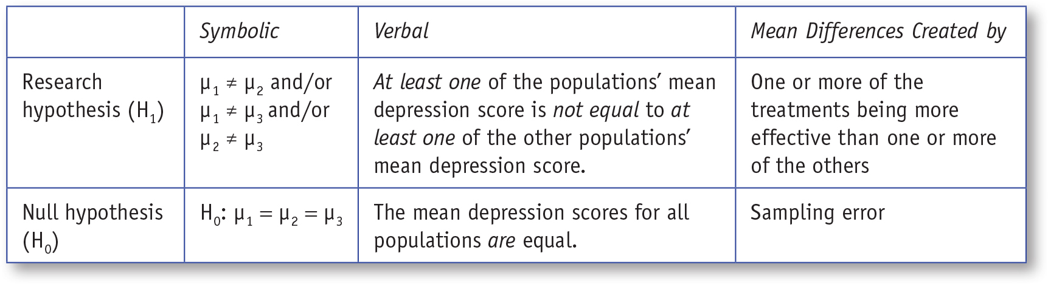
Table 11.2: Symbolic and Verbal Representations of Two-Tailed Research and Null Hypotheses for a One-Way Independent Samples ANOVA
Notes:
Learning Objective: Write null and research hypotheses using symbols and words

Slide 28
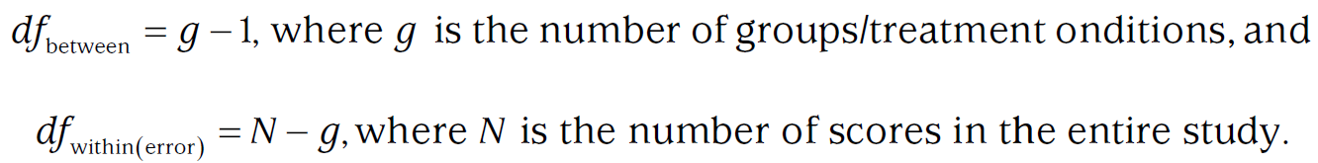
Step 3: Compute the Degrees of Freedom and Define the Critical Regions
To find the F critical value. You will need one df value based on the number of participants and another df value based on the number of groups.
Notes:
Learning Objective: Complete an ANOVA summary table by computing the degrees of freedom, SSs, MSs, and F ratio

Slide 29
Step 3: Compute the Degrees of Freedom and Define the Critical Regions
In this example
df_{between} = g − 1 = 3 − 1 = 2
df_{within(error)} = N − g = 18 − 3 = 15
Find the critical value of F in Appendix C, for α of .05
When df_{between} = 2 and df_{within(error)} = 15, the F critical value is 3.68.
Notes:
Learning Objective: Complete an ANOVA summary table by computing the degrees of freedom, SSs, MSs, and F ratio

Slide 30
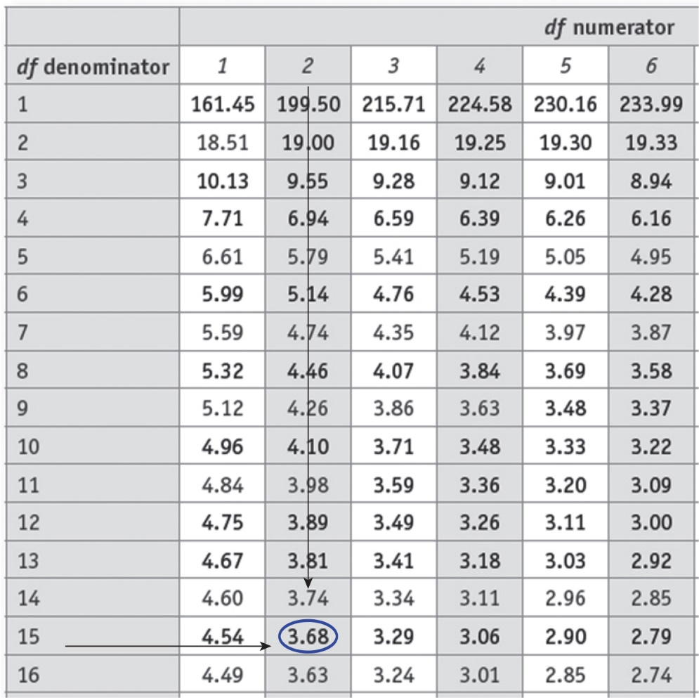
Figure 11.1: Finding the Critical Value for an ANOVA With α = .05
Notes:
Learning Objective: Complete an ANOVA summary table by computing the degrees of freedom, SSs, MSs, and F ratio

Slide 31
Step 4: Compute the Test Statistic (Independent ANOVA)
An ANOVA source table is a valuable summary of the ANOVA statistical analysis because it shows how the obtained F is created.
Notes:
Learning Objective: Complete an ANOVA summary table by computing the degrees of freedom, SSs, MSs, and F ratio

Slide 32
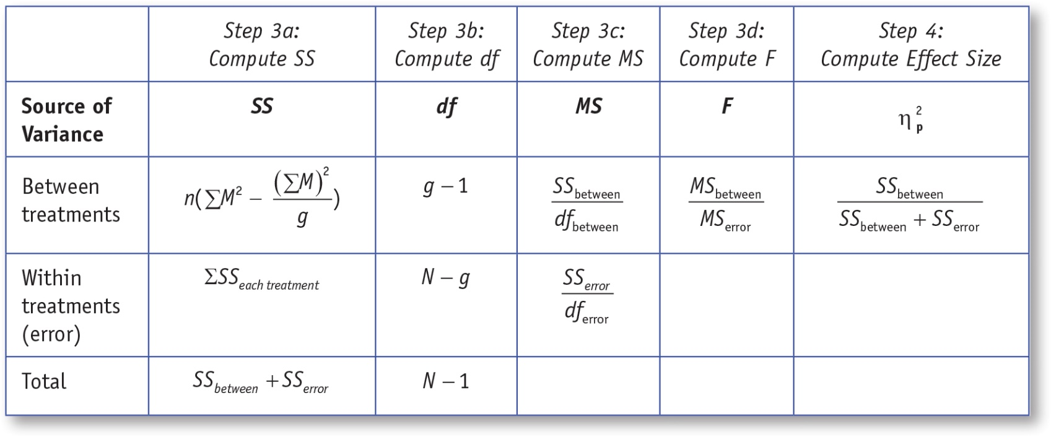
Table 11.3: An ANOVA Source Table With Formulas
Notes:
Learning Objective: Complete an ANOVA summary table by computing the degrees of freedom, SSs, MSs, and F ratio
p. 376
“Note: g = number of IV conditions (g = 3; CBT, PDT, NT), N = number of people in the study (in this case, 18), and n = number of scores in each condition.”

Slide 33
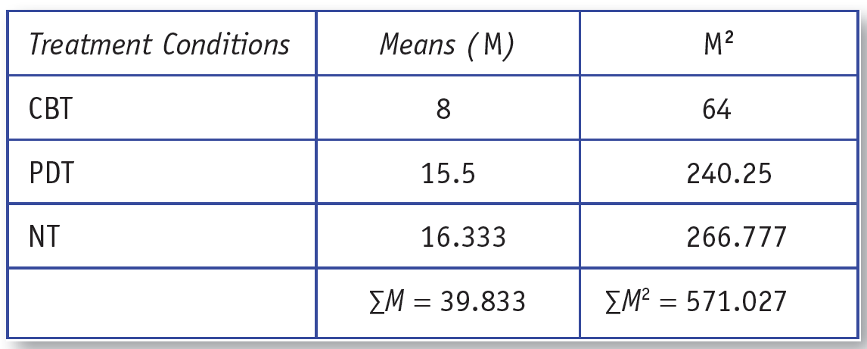
4a to 4d: Completing the ANOVA Summary Table
Notes:
Learning Objective: Complete an ANOVA summary table by computing the degrees of freedom, SSs, MSs, and F ratio
p. 376, no table number

Slide 34
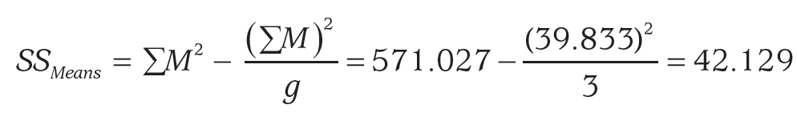
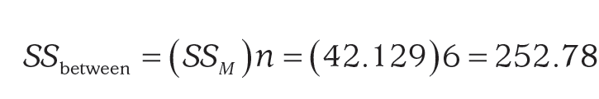
4a to 4d: Completing the ANOVA Summary Table
Notes:
Learning Objective: Complete an ANOVA summary table by computing the degrees of freedom, SSs, MSs, and F ratio

Slide 35
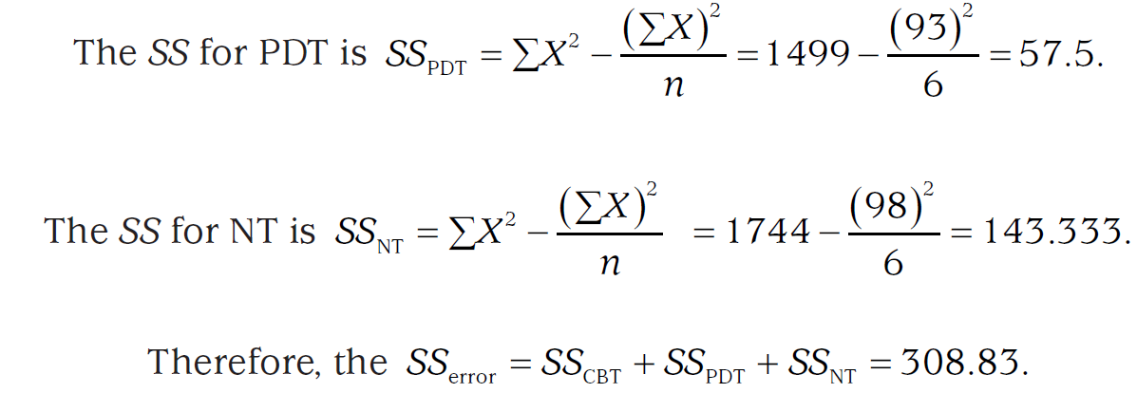
4a to 4d: Completing the ANOVA Summary Table
Notes:
Learning Objective: Complete an ANOVA summary table by computing the degrees of freedom, SSs, MSs, and F ratio

Slide 36
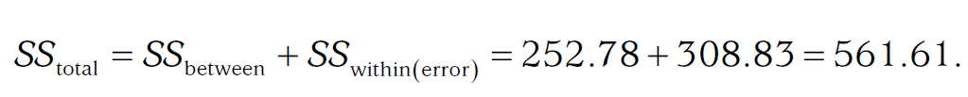
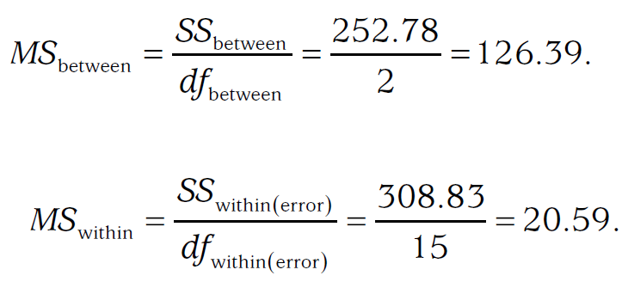
4a to 4d: Completing the ANOVA Summary Table
Notes:
Learning Objective: Complete an ANOVA summary table by computing the degrees of freedom, SSs, MSs, and F ratio

Slide 37
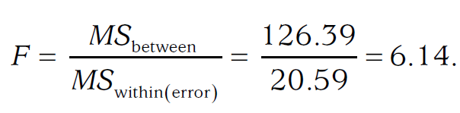
4a to 4d: Completing the ANOVA Summary Table
Obtained F = 6.14
Notes:
Learning Objective: Complete an ANOVA summary table by computing the degrees of freedom, SSs, MSs, and F ratio

Slide 38
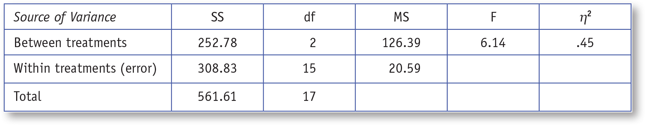
Table 11.4: A Complete ANOVA Source Table
Notes:
Learning Objective: Complete an ANOVA summary table by computing the degrees of freedom, SSs, MSs, and F ratio
p. 376
“Note: g = number of IV conditions (g = 3; CBT, PDT, NT), N = number of people in the study (in this case, 18), and n = number of scores in each condition.”

Slide 39
4a to 4d: Completing the ANOVA Summary Table
In this case, the obtained F value was 6.14, which is greater than the critical F value of 3.68 (α = .05).
Therefore, you reject the null hypothesis and conclude that at least one sample mean is significantly different from one of the others.
Notes:
Learning Objective: Define a critical region and determine if you should reject or fail to reject the null hypothesis

Slide 40
4e: If Necessary, Compute Post Hoc Tests
If you reject the null hypothesis and there are three or more IV conditions in the study, you need to perform pairwise post hoc tests to determine which pair or pairs of means are different from each other.
Notes:
Learning Objective: Explain when and why post hoc tests are necessary

Slide 41
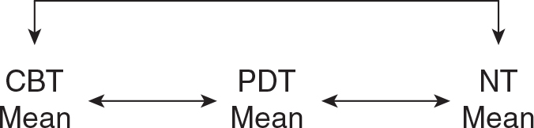
Figure 11.2: The Three Post Hoc Comparisons in This Study
Notes:
Learning Objective: Explain when and why post hoc tests are necessary
p. 376
“Note: g = number of IV conditions (g = 3; CBT, PDT, NT), N = number of people in the study (in this case, 18), and n = number of scores in each condition.”

Slide 42
4e: If Necessary, Compute Post Hoc Tests
There are a number of different post hoc tests that you can use.
The one we use is Tukey’s honestly significant difference (HSD) test.
Any pair of means that differ by more than the HSD value are significantly different, and unlikely to result from sampling error.
Notes:
Learning Objective: Explain when and why post hoc tests are necessary

Slide 43
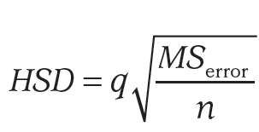
4e: If Necessary, Compute Post Hoc Tests
Tukey’s HSD formula
Notes:
Learning Objective: Explain when and why post hoc tests are necessary

Slide 44
4e: If Necessary, Compute Post Hoc Tests
For this example,
MS_{within(error)} = 20.59
n = 6
A table of q values is in Appendix D. In this case, g = 3, the df for the error term (df_{within(error)}) = 15, and the alpha level (α) = .05.
Based on these values, the q statistic is 3.67.
Notes:
Learning Objective: Explain when and why post hoc tests are necessary

Slide 45
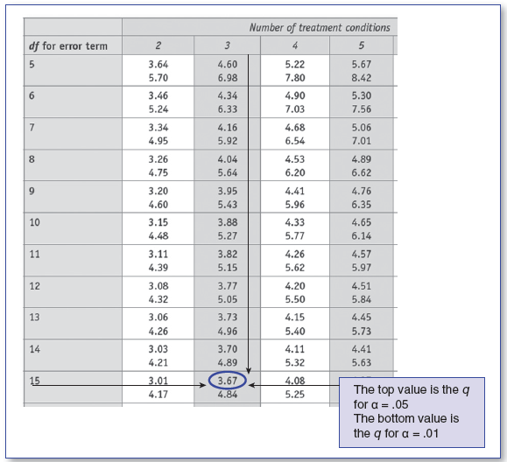
4e: If Necessary, Compute Post Hoc Tests
Notes:
Learning Objective: Explain when and why post hoc tests are necessary
p. 379, no table number

Slide 46
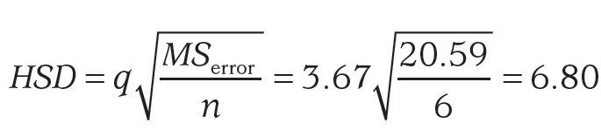
4e: If Necessary, Compute Post Hoc Tests
For this example, the HSD is 6.80
If the absolute value of the difference between means is greater than the HSD, then those means are significantly different from each other.
Notes:
Learning Objective: Explain when and why post hoc tests are necessary

Slide 47
4e: If Necessary, Compute Post Hoc Tests
Based on these analyses, you can conclude that the CBT group had significantly lower depression scores than the PDT group, suggesting that CBT is better for treating depression than PDT.
Similarly, the CBT group had significantly lower depression than the NT group, suggesting that CBT is better than NT.
Notes:
Learning Objective: Explain when and why post hoc tests are necessary

Slide 48
4e: If Necessary, Compute Post Hoc Tests
Finally, the PDT and NT groups were not significantly different.
Therefore, the numerical difference between means is likely created by sampling error.
These results suggest that PDT is no better at treating depression than no treatment at all.
Notes:
Learning Objective: Explain when and why post hoc tests are necessary

Slide 49
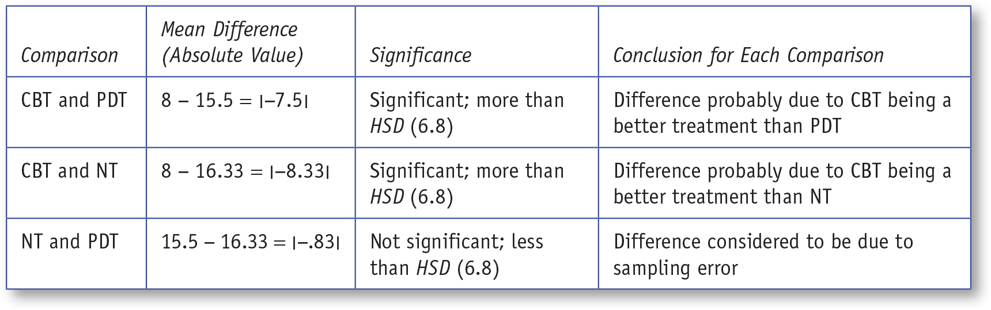
Table 11.5: Post Hoc Comparisons
Notes:
Learning Objective: Explain when and why post hoc tests are necessary

Slide 50
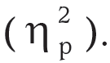
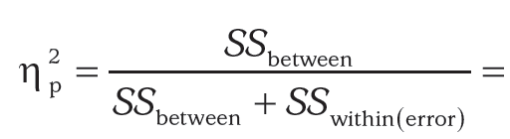
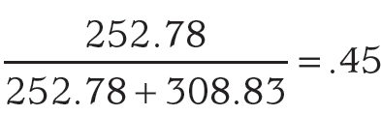
Step 5: Compute an Effect Size and Describe It
The most common effect size for ANOVAs is partial η²
Notes:
Learning Objective: Explain when and why post hoc tests are necessary

Slide 51
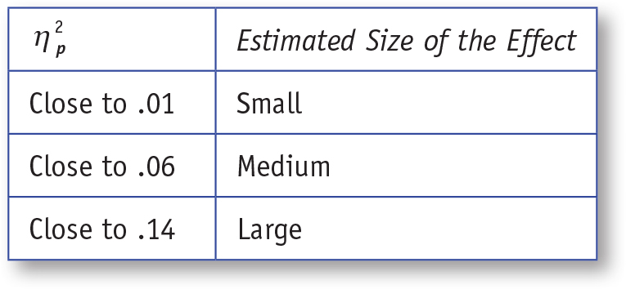
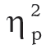
Table 11.6: General Guidelines for Interpreting
Notes:
Learning Objective: Explain when and why post hoc tests are necessary

Slide 52
Step 5: Compute an Effect Size and Describe It
For one-way ANOVAs, you should interpret the partial η² as the percentage of DV variability the IV “explains.”
In this case, the type of treatment participants receive “explains” 45% of the variability in their depression scores.
This is a large effect.
Notes:
Learning Objective: Explain when and why post hoc tests are necessary

Slide 53
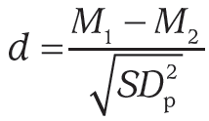
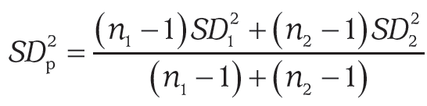
Step 5: Compute an Effect Size and Describe It
You can also compute an effect size for each comparison so you know how much more effective each type of treatment was than the other treatments.
Notes:
Learning Objective: Explain when and why post hoc tests are necessary

Slide 54
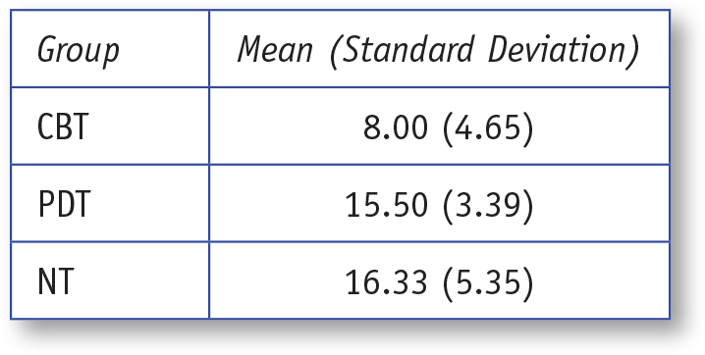
Table 11.7: Mean and Standard Deviations for Each Treatment Type
Notes:
Learning Objective: Explain when and why post hoc tests are necessary

Slide 55
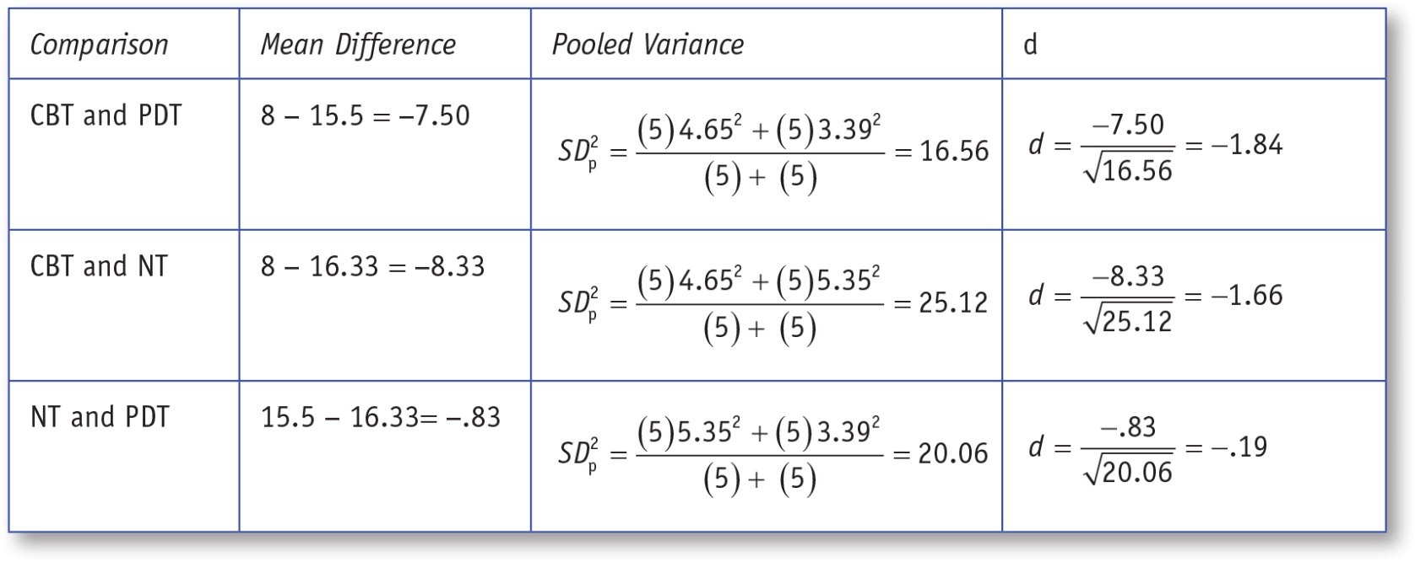
Table 11.8: Effect Sizes (d) for Pairwise Comparisons
Notes:
Learning Objective: Explain when and why post hoc tests are necessary

Slide 56
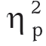
Step 6: Interpreting the Results of the Hypothesis Test
An independent ANOVA revealed meaningful differences among the three depression therapies, F(2, 15) = 6.14, p < .05, = .45, MSE = 20.59. The means and standard deviations for each treatment condition are in Table 11.9.
Notes:
Learning Objective: Summarize the results of an independent samples ANOVA using American Psychological Association (APA) style

Slide 57
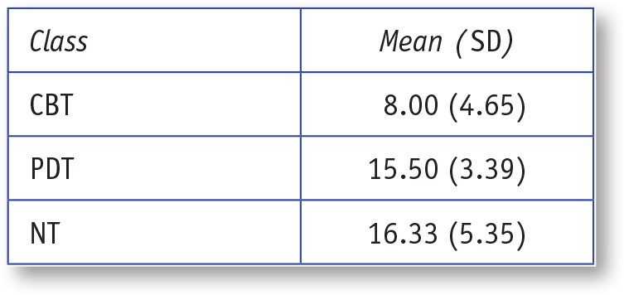
Table 11.9: Means and Standard Deviations for Each Condition
Notes:
Learning Objective: Summarize the results of an independent samples ANOVA using American Psychological Association (APA) style

Slide 58
Step 6: Interpreting the Results of the Hypothesis Test
Tukey’s HSD post hoc tests revealed that the CBT group had lower depression scores than both the PDT group and the no-treatment group. The PDT therapy was no better than receiving no treatment at all. The HSD post hoc tests and their effect sizes are in Table 11.10.
Notes:
Learning Objective: Summarize the results of an independent samples ANOVA using American Psychological Association (APA) style

Slide 59
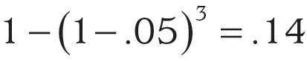
An Additional Note on ANOVAS: Family-Wise Error and α Inflation
Doing a single ANOVA rather than multiple t tests keeps the family-wise error rate at .05 for the overall ANOVA.
If you perform multiple t tests, the family-wise error = 1−(1− a)c where c is the number of comparisons.
With α set at .05, three comparisons would increase the Type I error rate to .14.

Slide 60
SPSS
Use SPSS to compute an independent samples ANOVA, including post hoc tests. Interpret the SPSS output for an independent samples ANOVA.
Notes:
Learning Objective: Use SPSS to compute an independent samples ANOVA, including post hoc tests Learning Objective: Interpret the SPSS output for an independent samples ANOVA

Slide 61
Data File
For the independent ANOVA, you will have one column to indicate which treatment each person received (IV).
1 = CBT
2 = PDT
3 = no therapy
and another column to indicate each person’s depression score (DV).
Notes:
Learning Objective: Use SPSS to compute an independent samples ANOVA, including post hoc tests
Learning Objective: Interpret the SPSS output for an independent samples ANOVA

Slide 62
Data File
Coding the IV
From the “Data View” screen, click on the “Variable View” tab at the bottom left of the screen.
On the “Variable View” screen, enter the variable names.
Then, across from the treatment variable, click on the cell under the “Values” column heading.
Notes:
Learning Objective: Use SPSS to compute an independent samples ANOVA, including post hoc tests
Learning Objective: Interpret the SPSS output for an independent samples ANOVA

Slide 63
Data File
Coding the IV
When a “button” appears, click on it. In the “Value” box, enter “1.”
In the “Label” box, enter CBT, and click the “Add” button.
Then, enter “2” and PDT in the Value and Label boxes, respectively, and click “Add.”
Finally, enter “3” and NT, click “Add,” and then click “OK.”
Notes:
Learning Objective: Use SPSS to compute an independent samples ANOVA, including post hoc tests
p. 384
“Your data file should look like the one in Figure 11.3.”

Slide 64
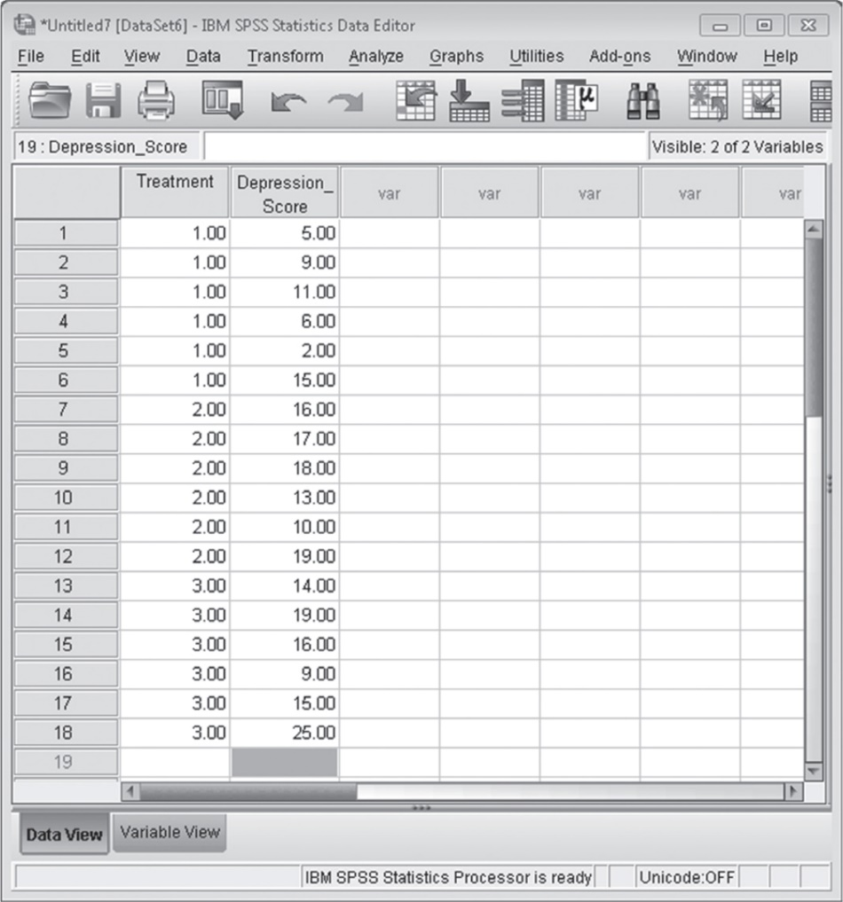
Figure 11.3: SPSS Screenshot of Data Entry Screen
Notes:
Learning Objective: Use SPSS to compute an independent samples ANOVA, including post hoc tests

Slide 65
Computing an Independent Samples ANOVA
Click on the Analyze menu. Choose General Linear Model and then select Univariate.
Move the IV into the Fixed Factors box and move the DV into the Dependent Variable box.
Click on Options and then check Descriptive Statistics and Estimates of Effect Size.
Click on Continue.
Notes:
Learning Objective: Use SPSS to compute an independent samples ANOVA, including post hoc tests

Slide 66
Computing an Independent Samples ANOVA
To obtain post hoc tests, click on the Post Hoc button and then move the IV into the box labeled.
Post hoc tests for.
Select the Tukey check box and then Continue.
Click on OK to run the ANOVA.
Notes:
Learning Objective: Use SPSS to compute an independent samples ANOVA, including post hoc tests

Slide 67
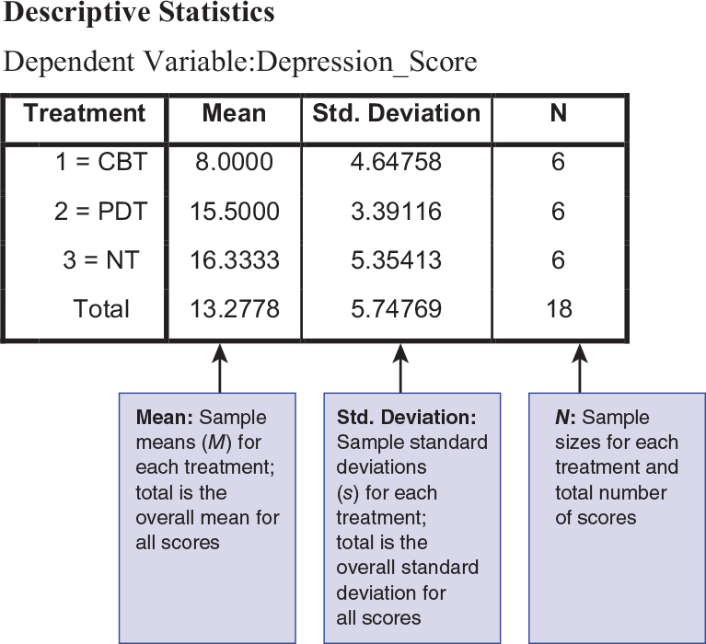
Figure 11.4: SPSS Screenshot of Descriptive Statistics
Notes:
Learning Objective: Interpret the SPSS output for an independent samples ANOVA

Slide 68
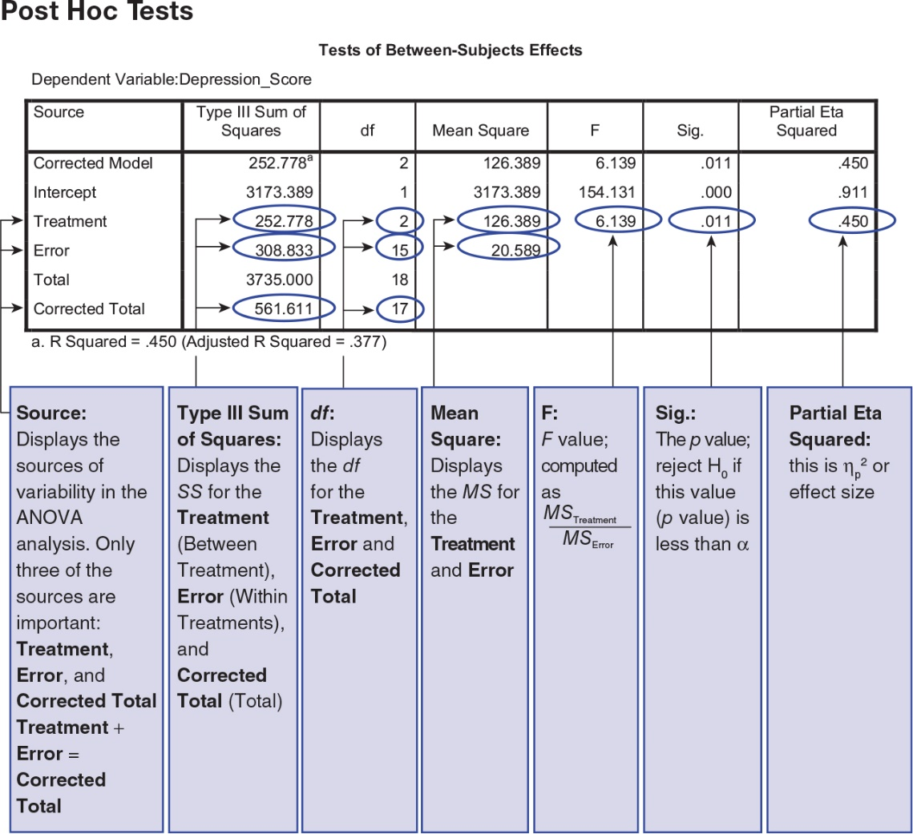
Figure 11.5: SPSS Screenshot of ANOVA Source Table
Notes:
Learning Objective: Interpret the SPSS output for an independent samples ANOVA

Slide 69
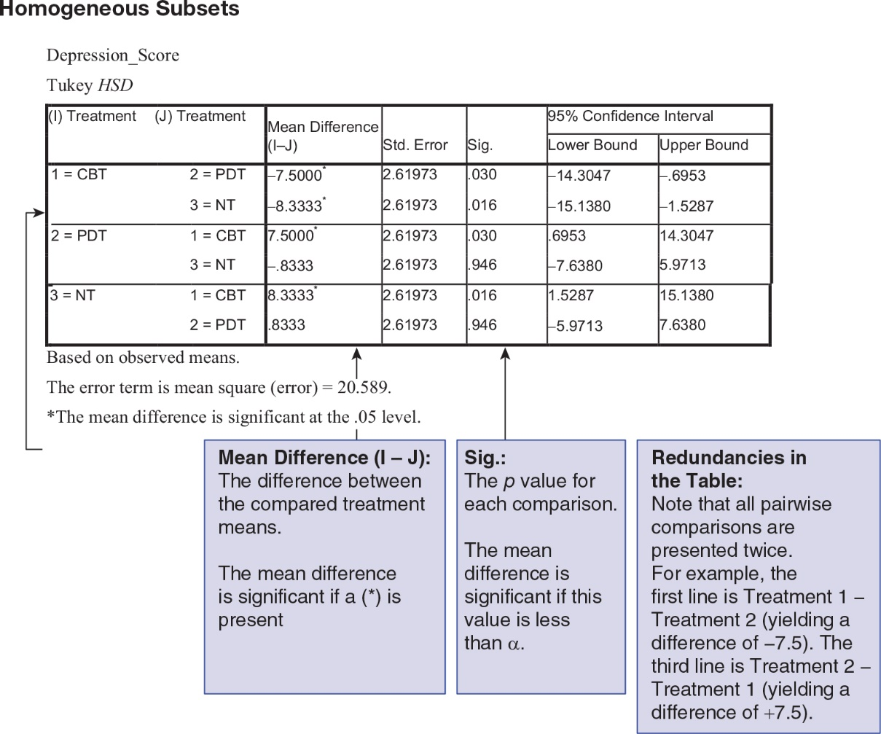
Figure 11.6: An SPSS Screenshot of Post Hoc Tests With Pairwise Comparisons
Notes:
Learning Objective: Interpret the SPSS output for an independent samples ANOVA

Slide 70
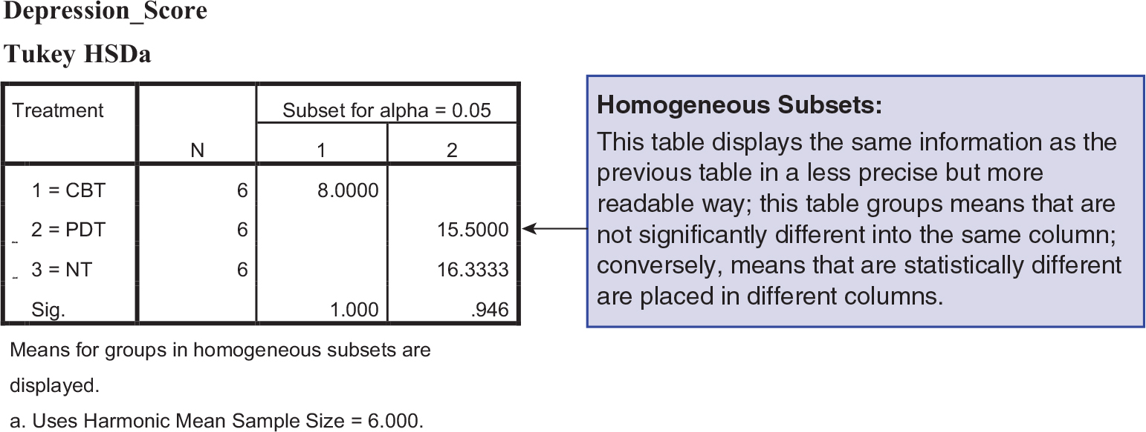
Figure 11.7: An SPSS Screenshot of Post Hoc Tests With Homogeneous Subsets
Notes:
Learning Objective: Interpret the SPSS output for an independent samples ANOVA

